Slide 1
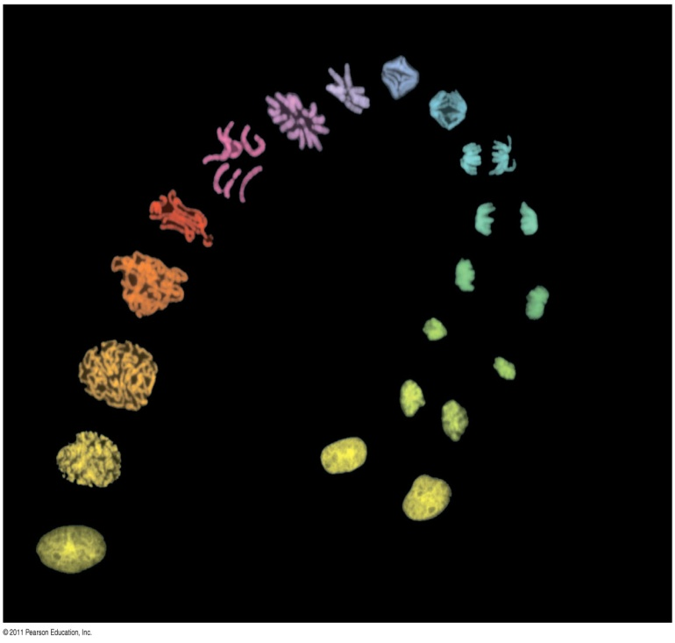
The Cell Cycle
Chapter 12

Slide 2
The Key Roles of Cell Division
The ability of organisms to produce more of their own kind best distinguishes living things from nonliving matter
The continuity of life is based on the reproduction of cells, or cell division

Slide 3
The Key Roles of Cell Division
In unicellular organisms, division of one cell reproduces the entire organism
Multicellular organisms depend on cell division for
Development from a fertilized cell
Growth
Repair
Cell division is an integral part of the cell cycle, the life of a cell from formation to its own division

Slide 4
The functions of cell division
Reproduction
Growth and development
Tissue renewal

Slide 5
Most cell division results in genetically identical daughter cells
Most cell division results in daughter cells with identical genetic information, DNA
The exception is meiosis, a special type of division that can produce sperm and egg cells

Slide 6
Cellular Organization of the Genetic Material
All the DNA in a cell constitutes the cell’s genome
A genome can consist of a single DNA molecule (common in prokaryotic cells) or a number of DNA molecules (common in eukaryotic cells)
DNA molecules in a cell are packaged into chromosomes

Slide 7
Eukaryotic chromosomes

Slide 8
Cellular Organization of the Genetic Material
Eukaryotic chromosomes consist of chromatin, a complex of DNA and protein that condenses during cell division
Every eukaryotic species has a characteristic number of chromosomes in each cell nucleus
Somatic cells (nonreproductive cells) have two sets of chromosomes
Gametes (reproductive cells: sperm and eggs) have half as many chromosomes as somatic cells

Slide 9
Distribution of Chromosomes During Eukaryotic Cell Division
In preparation for cell division, DNA is replicated and the chromosomes condense
Each duplicated chromosome has two sister chromatids (joined copies of the original chromosome), which separate during cell division
The centromere is the narrow “waist” of the duplicated chromosome, where the two chromatids are most closely attached

Slide 10
Chromosome
Sister chromatids
Centromere

Slide 11
Distribution of Chromosomes During Eukaryotic Cell Division
During cell division, the two sister chromatids of each duplicated chromosome separate and move into two nuclei
Once separate, the chromatids are called chromosomes

Slide 12
Chromosome duplication and distribution during cell division
Chromosomal DNA molecules
Chromosomes
Chromosome arm
Sister chromatids
Separation of sister chromatids into two chromosomes

Slide 13
Chromosome duplication and distribution during cell division
Eukaryotic cell division consists of:
Mitosis, the division of the genetic material in the nucleus
Cytokinesis, the division of the cytoplasm
Gametes are produced by a variation of cell division called meiosis
Meiosis yields nonidentical daughter cells that have only one set of chromosomes, half as many as the parent cell

Slide 14
The mitotic phase alternates with interphase in the cell cycle
In 1882, the German anatomist Walther Flemming developed dyes to observe chromosomes during mitosis and cytokinesis

Slide 15
Phases of the Cell Cycle
The cell cycle consists of:
Mitotic (M) phase (mitosis and cytokinesis)
Interphase (cell growth and copying of chromosomes in preparation for cell division)

Slide 16
Phases of the Cell Cycle
Interphase (about 90% of the cell cycle) can be divided into subphases
G₁ phase (“first gap”)
S phase (“synthesis”)
G₂ phase (“second gap”)
The cell grows during all three phases, but chromosomes are duplicated only during the S phase

Slide 17
The Cell Cycle
INTERPHASE
S (DNA synthesis
G₁
G₂
Cytokinesis
MITOTIC (M) PHASE
Mitosis

Slide 18
The Cell Cycle
Mitosis is conventionally divided into five phases:
Prophase
Prometaphase
Metaphase
Anaphase
Telophase
Cytokinesis overlaps the latter stages of mitosis

Slide 19
Exploring: Mitosis in an Animal Cell
G₂ of Interphase
Prophase
Prometaphase
Centrosomes (with centriole pairs)
Aster
Early mitotic spindle
Chromatin (duplicated
Kinetochore
Chromosome, consisting of two sister chromatids

Slide 20
Exploring: Mitosis in an Animal Cell
Metaphase
Anaphase
Telophase and Cytokinesis
Daughter chromosomes
Cleavage furrow
Spindle
Nuclear envelope forming
Centrosome at one spindle pole

Slide 21
The Mitotic Spindle: A Closer Look
The mitotic spindle is a structure made of microtubules that controls chromosome movement during mitosis
In animal cells, assembly of spindle microtubules begins in the centrosome, the microtubule organizing center
The centrosome replicates during interphase, forming two centrosomes that migrate to opposite ends of the cell during prophase and prometaphase

Slide 22
The Mitotic Spindle: A Closer Look
An aster (a radial array of short microtubules) extends from each centrosome
The spindle includes the centrosomes, the spindle microtubules, and the asters

Slide 23
The Mitotic Spindle: A Closer Look
During prometaphase, some spindle microtubules attach to the kinetochores of chromosomes and begin to move the chromosomes
Kinetochores are protein complexes associated with centromeres
At metaphase, the chromosomes are all lined up at the metaphase plate, an imaginary structure at the midway point between the spindle’s two poles

Slide 24
Mitosis in an Animal Cell
In anaphase, sister chromatids separate and move along the kinetochore microtubules toward opposite ends of the cell
The microtubules shorten by depolymerizing at their kinetochore ends

Slide 25
Mitosis in an Animal Cell
Nonkinetochore microtubules from opposite poles overlap and push against each other, elongating the cell
In telophase, genetically identical daughter nuclei form at opposite ends of the cell
Cytokinesis begins during anaphase or telophase and the spindle eventually disassembles

Slide 26
Cytokinesis: A Closer Look
In animal cells, cytokinesis occurs by a process known as cleavage, forming a cleavage furrow
In plant cells, a cell plate forms during cytokinesis

Slide 27
Cytokinesis: A Closer Look
Cleavage of an animal cell (SEM)
Cell plate formation in a plant cell (TEM)
Cleavage furrow
Contractile ring of microfilaments
Daughter cells

Slide 28
Binary Fission in Bacteria
Prokaryotes (bacteria and archaea) reproduce by a type of cell division called binary fission
In binary fission, the chromosome replicates (beginning at the origin of replication), and the two daughter chromosomes actively move apart
The plasma membrane pinches inward, dividing the cell into two

Slide 29
Bacterial cell division by binary fission
E. coli cell
Chromosome replication begins.
Two copies of origin
Replication continues.
Origin
Origin
Replication finishes.
Two daughter cells result.

Slide 30
The eukaryotic cell cycle is regulated by a molecular control system
The frequency of cell division varies with the type of cell
These differences result from regulation at the molecular level
Cancer cells manage to escape the usual controls on the cell cycle

Slide 31
Evidence for Cytoplasmic Signals
The cell cycle appears to be driven by specific chemical signals present in the cytoplasm
Some evidence for this hypothesis comes from experiments in which cultured mammalian cells at different phases of the cell cycle were fused to form a single cell with two nuclei

Slide 32
The Cell Cycle Control System
The sequential events of the cell cycle are directed by a distinct cell cycle control system, which is similar to a clock
The cell cycle control system is regulated by both internal and external controls
The clock has specific checkpoints where the cell cycle stops until a go-ahead signal is received

Slide 33
Mechanical analogy for the cell cycle control system
G₁ checkpoint
Control system
G₁
S
M
G₂
M checkpoint
G₂ checkpoint

Slide 34
Mechanical analogy for the cell cycle control system
For many cells, the G₁ checkpoint seems to be the most important
If a cell receives a go-ahead signal at the G₁ checkpoint, it will usually complete the S, G₂, and M phases and divide
If the cell does not receive the go-ahead signal, it will exit the cycle, switching into a nondividing state called the G₀ phase

Slide 35
The G₁ checkpoint
G₀
G₁ checkpoint
G₁
G₁
Cell receives a go-ahead signal.
Cell does not receive a go-ahead signal.

Slide 36
The Cell Cycle Clock: Cyclins and Cyclin-Dependent Kinases
Two types of regulatory proteins are involved in cell cycle control: cyclins and cyclin-dependent kinases (Cdks)
Cdks activity fluctuates during the cell cycle because it is controled by cyclins, so named because their concentrations vary with the cell cycle
MPF (maturation-promoting factor) is a cyclin-Cdk complex that triggers a cell’s passage past the G₂ checkpoint into the M phase

Slide 37
Stop and Go Signs: Internal and External Signals at the Checkpoints
An example of an internal signal is that kinetochores not attached to spindle microtubules send a molecular signal that delays anaphase
Some external signals are growth factors, proteins released by certain cells that stimulate other cells to divide
For example, platelet-derived growth factor (PDGF) stimulates the division of human fibroblast cells in culture

Slide 38
The effect of platelet-derived growth factor (PDGF) on cell division
A sample of human connective tissue is cut up into small pieces.
Scalpels
Enzymes digest the extracellular matrix, resulting in a suspension of free fibroblasts
PDGF is added to half the vessels.
Cells are transferred to culture vessels.
Without PDGF
With PDGF

Slide 39
Stop and Go Signs: Internal and External Signals at the Checkpoints
A clear example of external signals is density-dependent inhibition, in which crowded cells stop dividing
Most animal cells also exhibit anchorage dependence, in which they must be attached to a substratum in order to divide
Cancer cells exhibit neither density-dependent inhibition nor anchorage dependence

Slide 40
Density-dependent inhibition and anchorage dependence of cell division
Anchorage dependence
Density-dependent inhibition
Density-dependent inhibition
Cancer cells
Normal mammalian cells

Slide 41
Loss of Cell Cycle Controls in Cancer Cells
Cancer cells do not respond normally to the body’s control mechanisms
Cancer cells may not need growth factors to grow and divide
They may make their own growth factor
They may convey a growth factor’s signal without the presence of the growth factor
They may have an abnormal cell cycle control system

Slide 42
Loss of Cell Cycle Controls in Cancer Cells
A normal cell is converted to a cancerous cell by a process called transformation
Cancer cells that are not eliminated by the immune system form tumors, masses of abnormal cells within otherwise normal tissue
If abnormal cells remain only at the original site, the lump is called a benign tumor
Malignant tumors invade surrounding tissues and can metastasize, exporting cancer cells to other parts of the body, where they may form additional tumors

Slide 43
The growth and metastasis of a malignant breast tumor
tumor
Lymph vessel
Blood vessel
Glandular tissue
Cancer cell
A tumor grows from a single cancer cell.
Cancer cells spread through lymph and blood vessels to other parts of the body.
Cancer cells invade neighboring tissue.
Cancer cells may survive and establish a new tumor in another part of the body.

Slide 44
Loss of Cell Cycle Controls in Cancer Cells
Recent advances in understanding the cell cycle and cell cycle signaling have led to advances in cancer treatment

Slide 45
The End

